Slide 1
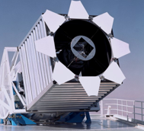
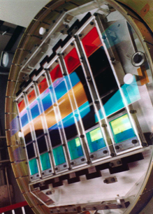
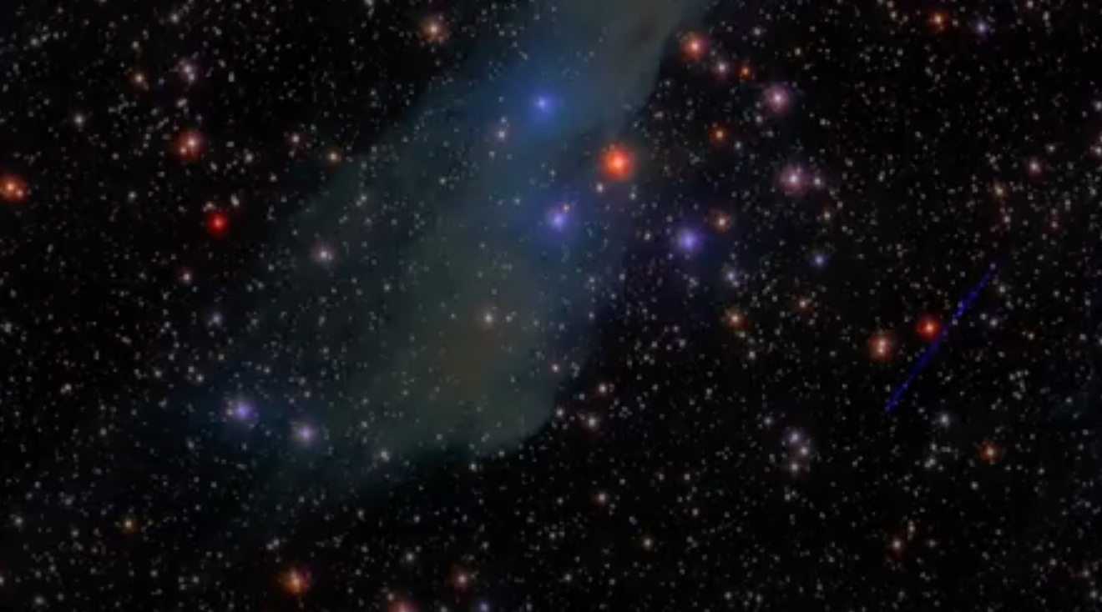
Sloan Digital Sky Survey: Stellar Classification
Mini Project 2 –Supervised Learning
Jeremy Roscoe
July 2024

Slide 2
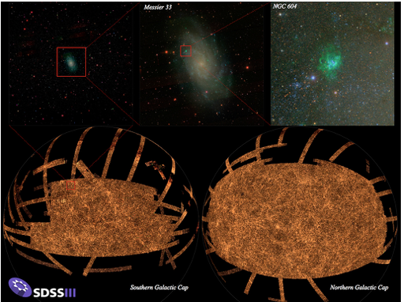
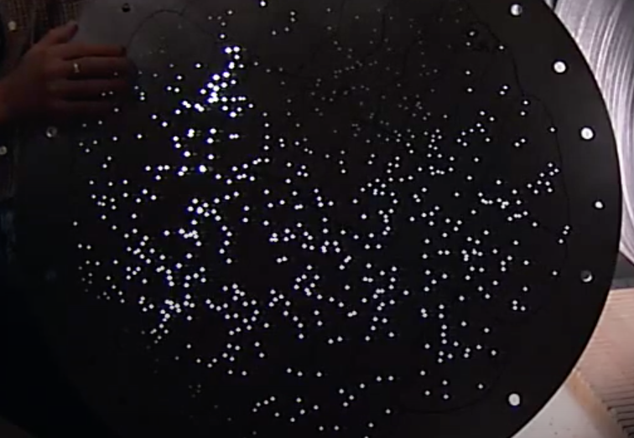
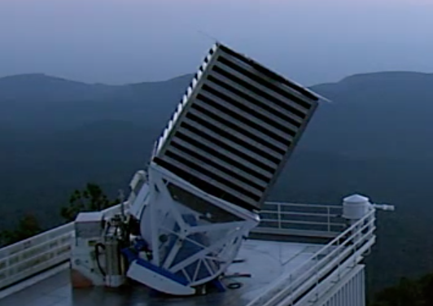
What Is SDSS?
A survey of bright objects in Northern hemisphere night sky from Apache, NM
Combines 2.5m telescope with an imaging camera and a spectrograph
Uses a large field of view with drilled aluminium plates centred on bright objects
Covers about 10,000 square degrees
https://www.sdss4.org

Slide 3
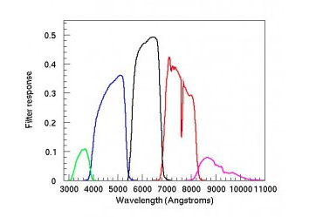
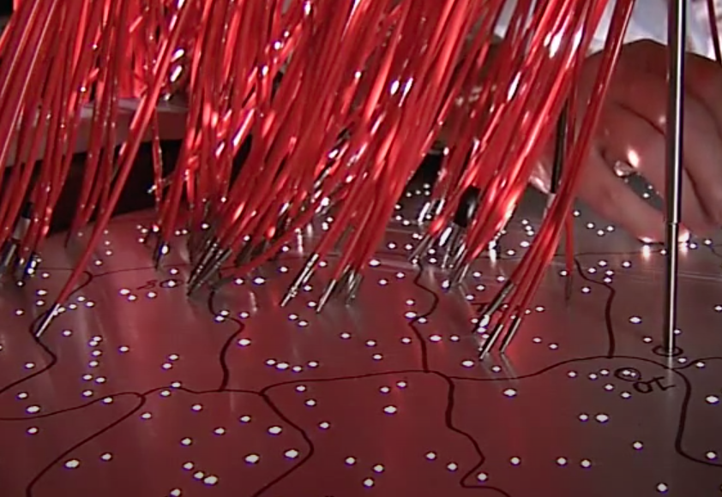
What Is SDSS?
Uses 5 distinct colour range filters: u,g,r,i,z
Slowly reads spectroscopic data as it drifts in circular arcs
Has individual fibres centered on bright points

Slide 4
What is this used for?
Creating 3D maps of the observable universe
Understanding the formation and structure of our universe
What is the value?
SDSS - Mapping the universe
A flight through the universe

Slide 5
Now we have spectra for bright light sources… What are they?
Stars from our local cluster or even the Milky Way
Galaxies of varying shapes, sizes and distances from us
Quasars, the brightest objects in our universe, from early in our universe’s formation.
What is the problem?

Slide 6

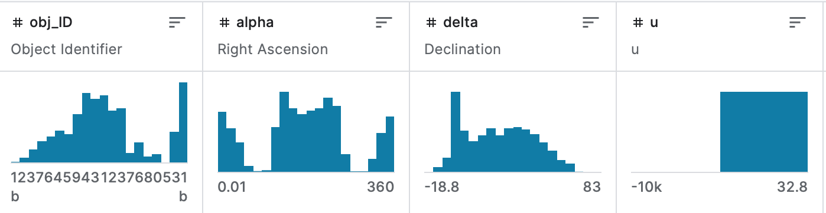
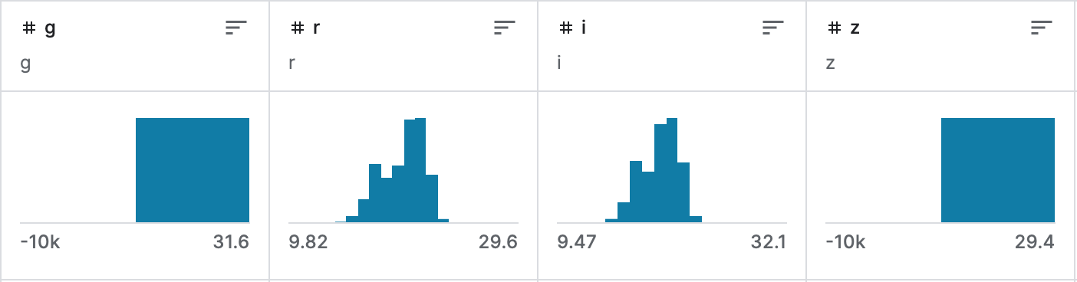
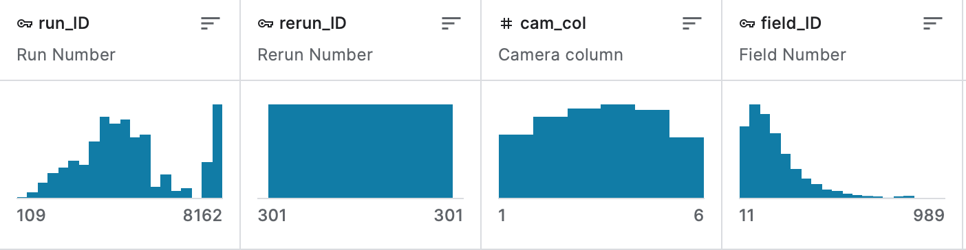
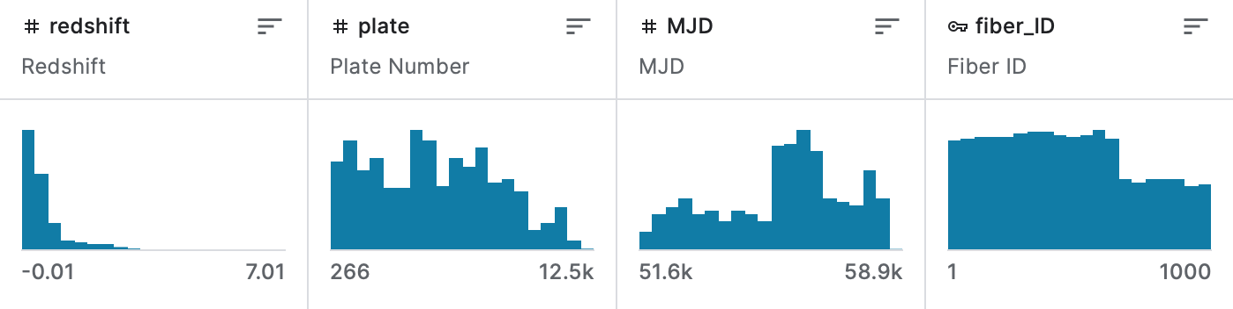
Data Cleaning- What does the raw data look like?
100,000 Observations
18 Attributes

Slide 7
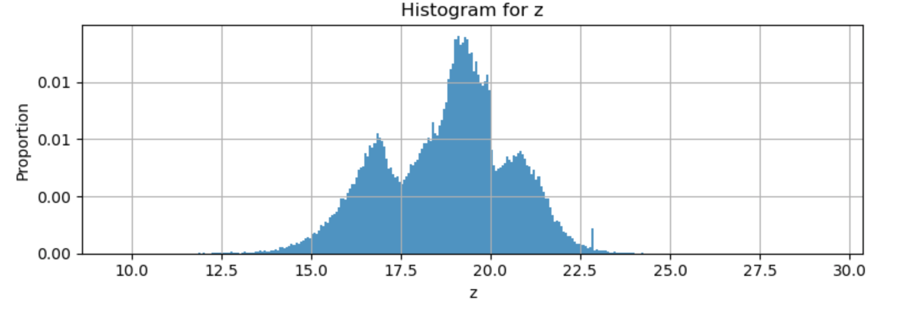
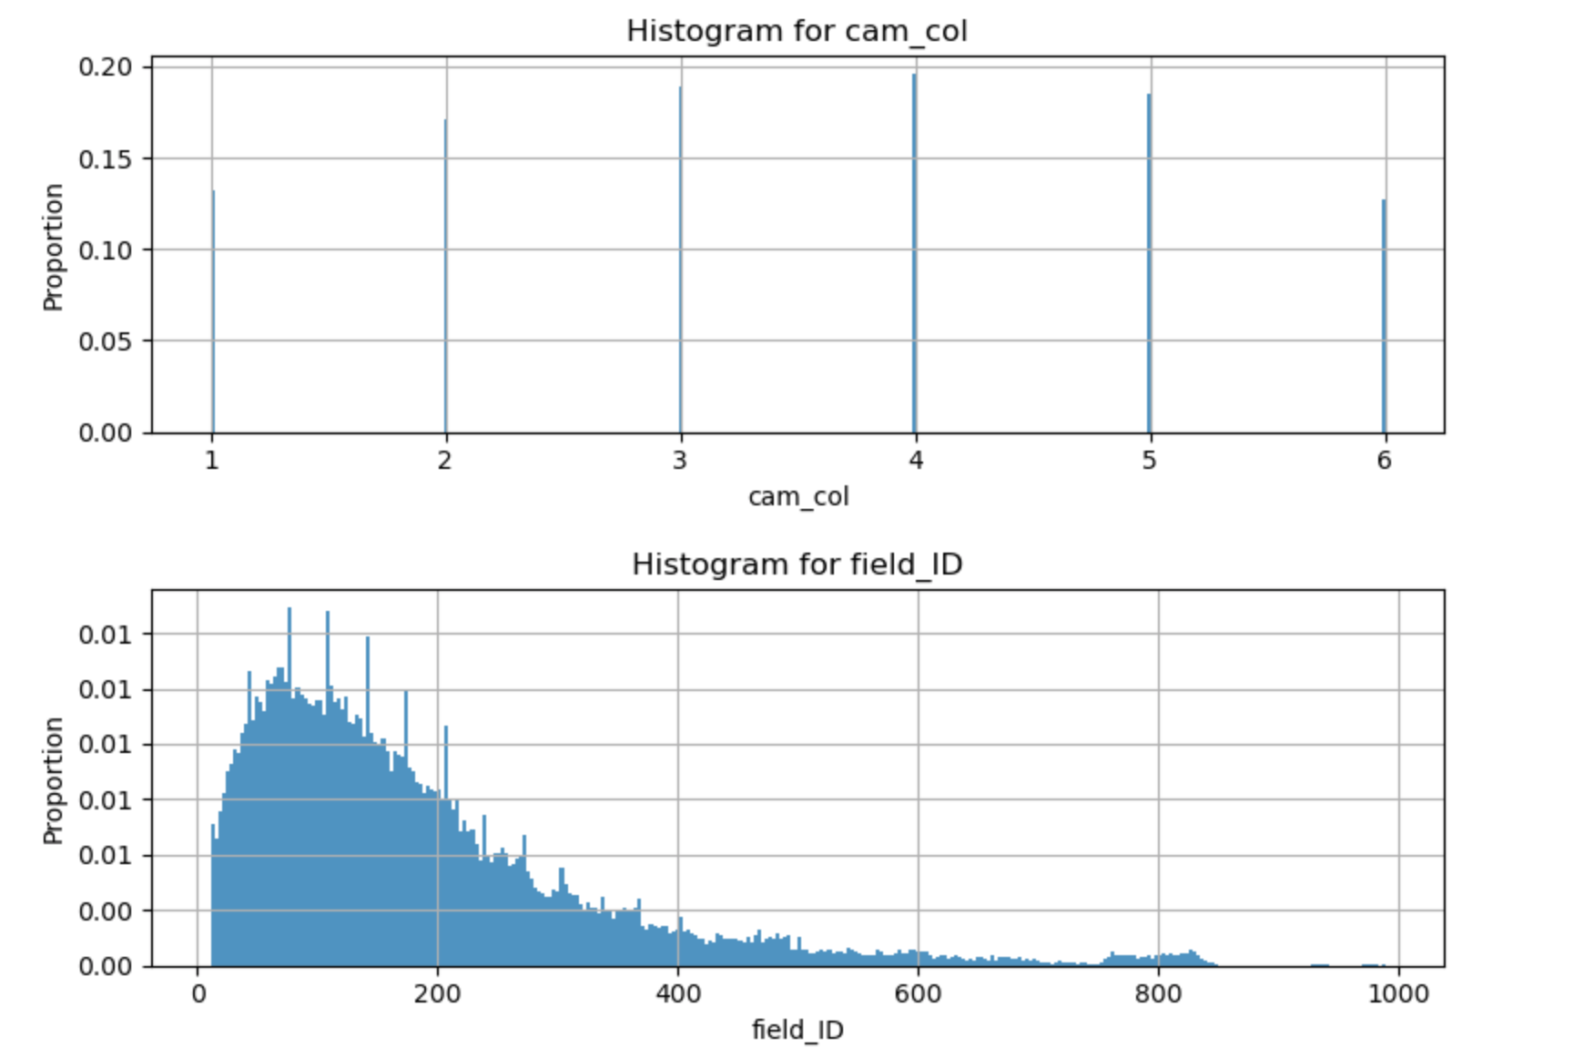
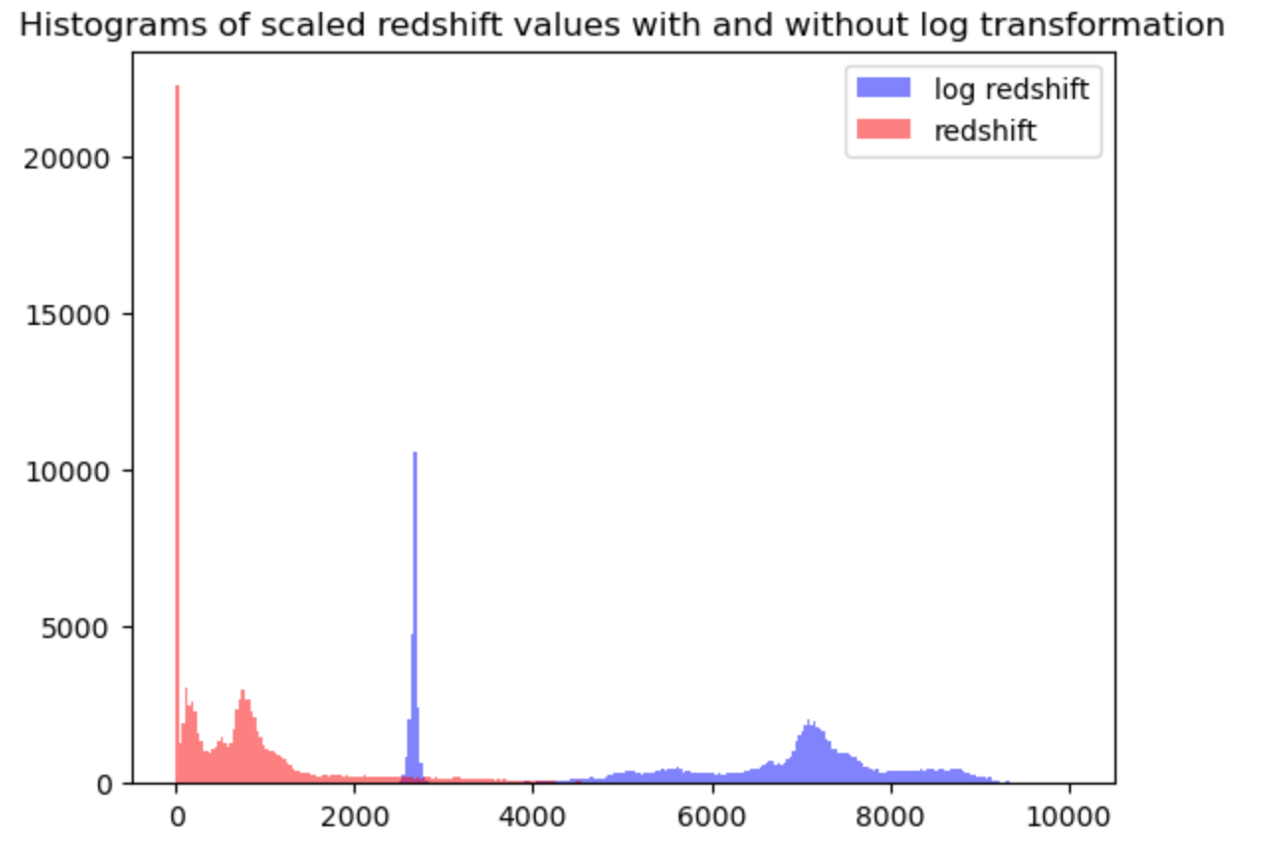
Data Cleaning
Varied Distributions
Multiple Overlapping Distributions
Extreme Outliers
Mixed Discrete & Continuous Variables
Bounded Distributions
Truncated Values
Encoded Variables

Slide 8
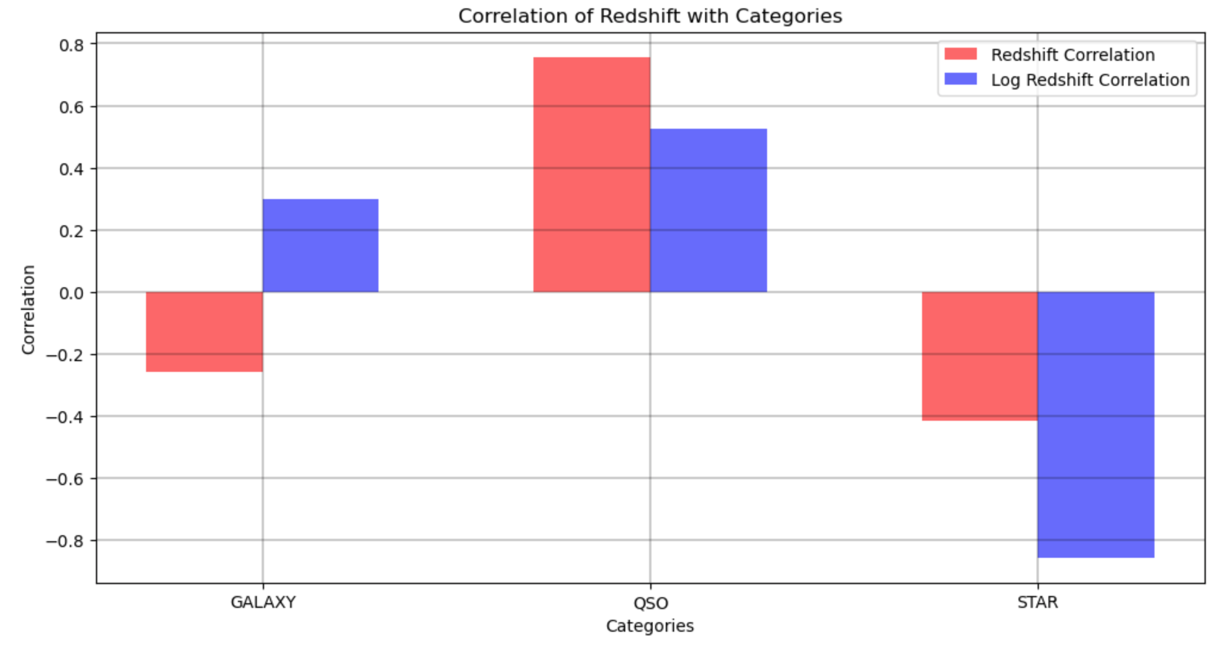
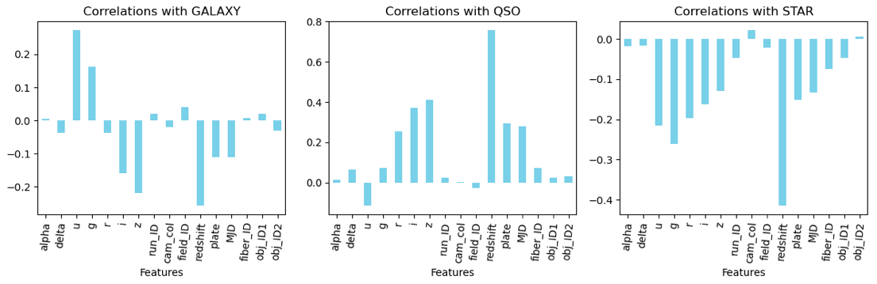
Cleaned Data Correlations

Slide 9
Feature Cleaning/
Engineering
Small Scale Modelling
Large Scale Modelling
Minmax scaling
Logarithmic transforms
Rounding error investigation
Truncation error investigation
200 row sample
Feature importance evaluation
Hyperparameter grid-search
Full set extrapolation
80:20 data split
Test set accuracy evaluation
Model comparisons
Modelling Pipeline

Slide 10


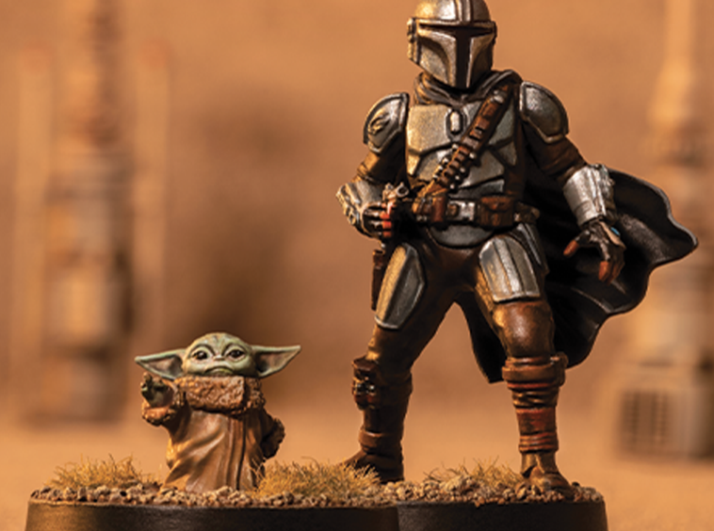
Models used for classification :
Logistic Regression
Decision Tree
Random Forest
AdaBoosted Gaussian Naïve Bayes
AdaBoosted Decision Tree
Light Gradient Boosting Machine
Stacking
KNN

Slide 11
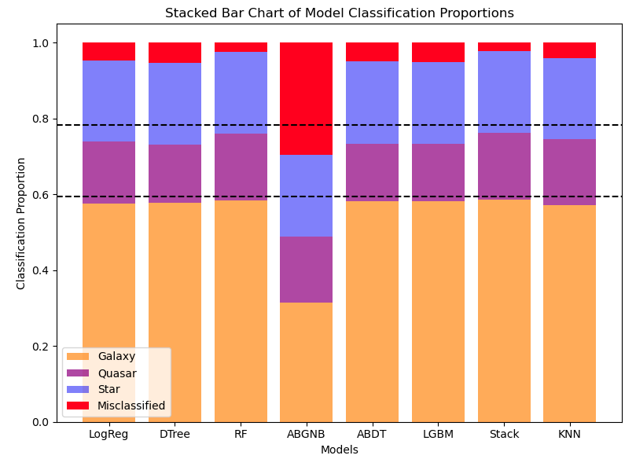
Insights:
Highest Accuracy: Stacked model 97.74% (test) 99.98% (train)
Stellar bodies can be classified to a high degree of accuracy from spectrographic data
Worst Accuracy: Adaboosted Gaussian Naïve Bayes 70.37% (test) 70.02% (train)
Log transformed red-shift is always the least important top feature so contains a lot of the info of the other variables and a bit more
Many optimised models can have high accuracy (~94%) even when trained on small proportions of the dataset (<0.5%)

Slide 12
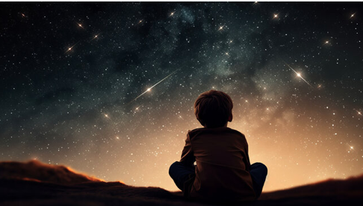
Growth & Next Steps:
Utilise GPU and cloud processing environments
Investigate increasing randomness in base models for stacking
Perform statistical analyses of feature importance for each model
Perform exploratory analysis of training set size on predictive power
Perform statistical analysis on model improvement due to feature engineering
Utilise the sdsspy.util.photoid_extract() function to get meaningful data from the ID columns
Acquire data direct from SDSS source in raw form
Look at distribution segmentation
Combine northern and southern hemisphere data into a complete night sky mapping and classification
Thankyou

